Slide 1
JAVA DATA TYPES

Slide 2
Objectives
Understanding Java Syntax
Java Data Types
We will discuss about various types of data type
You will learn to accepting input from user
Command line arguments
You will learn to configure java environment
Understanding Java Keywords
Learn to execute java program

Slide 3
Objectives
Understanding Java Syntax
Java Data Types
We will discuss about various types of data type
You will learn to accepting input from user
Command line arguments
You will learn to configure java environment
Learn to execute java program

Slide 4
Classes in Java
A class is a group of objects that has common properties. It is a template or blueprint from which objects are created.
A class in java can contain:
data member
method
constructor
block
class and interface
Syntax to declare a class:
        class <class_name>
        {
        data member;
        method;
        }

Slide 5
class Student2{
int rollno;
String name;
void insertRecord(int r, String n){
rollno=r;
name=n;
}
void displayInformation(){System.out.println(rollno+" "+name);}
public static void main(String args[]){
Student2 s1=new Student2();
Student2 s2=new Student2();
s1.insertRecord(111,"Karan");
s2.insertRecord(222,"Aryan");
s1.displayInformation();
s2.displayInformation();
}
}

Slide 6
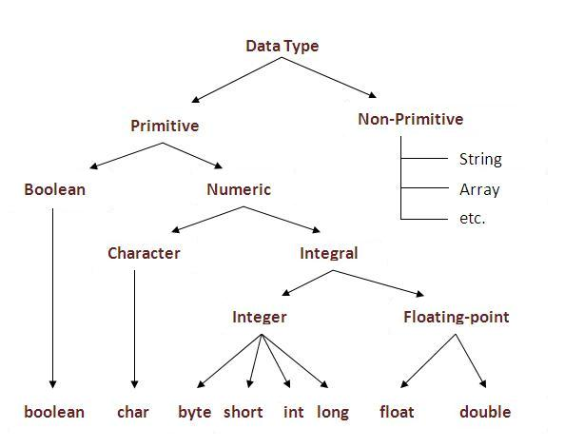
Java Basic Data Types
Variables are nothing but reserved memory locations to store values. This means that when you create a variable you reserve some space in memory.
Based on the data type of a variable, the operating system allocates memory and decides what can be stored in the reserved memory.
Therefore, by assigning different data types to variables, you can store integers, decimals,
or characters in these variables.
There are two data types available in Java:
• Primitive Data Types
• Non-Primitive Data Types

Slide 7
Primitive Data Types:
There are eight primitive data types supported by Java. Primitive data types are predefined by the language and
named by a keyword. Let us now look into detail about the eight primitive data types.
byte:
• Byte data type is an 8-bit signed two's complement integer.
• Minimum value is -128 (-2^7)
• Maximum value is 127 (inclusive)(2^7 -1)
• Default value is 0
• Byte data type is used to save space in large arrays, mainly in place of integers, since a byte is four times
smaller than an int.
• Example: byte a = 100, byte b = -50
short:
• Short data type is a 16-b
Minimum value is -32,768 (-2^15)
• Maximum value is 32,767(inclusive) (2^15 -1)
• Short data type can also be used to save memory as byte data type. A short is 2 times smaller than an int
• Default value is 0.
• Example: short s= 10000, short r = -20000 it signed two's complement integer.

Slide 8
int:
• int data type is a 32-bit signed two's complement integer.
• Minimum value is - 2,147,483,648.(-2^31)
• Maximum value is 2,147,483,647(inclusive).(2^31 -1)
• Int is generally used as the default data type for integral values unless there is a concern about memory.
• The default value is 0.
• Example: int a = 100000, int b = -200000
long:
• Long data type is a 64-bit signed two's complement integer.
• Minimum value is -9,223,372,036,854,775,808.(-2^63)
• Maximum value is 9,223,372,036,854,775,807 (inclusive). (2^63 -1)
• This type is used when a wider range than int is needed.
• Default value is 0L.
• Example: int a = 100000L, int b = -200000L

Slide 9
float:
• Float data type is a single-precision 32-bit IEEE 754 floating point.
• Float is mainly used to save memory in large arrays of floating point numbers.
• Default value is 0.0f.
• Float data type is never used for precise values such as currency.
• Example: float f1 = 234.5f

Slide 10
double:
• double data type is a double-precision 64-bit IEEE 754 floating point.
• This data type is generally used as the default data type for decimal values, generally the default choice.
• Double data type should never be used for precise values such as currency.
• Default value is 0.0d.
• Example: double d1 = 123.4
boolean:
• boolean data type represents one bit of information.
• There are only two possible values: true and false.
• This data type is used for simple flags that track true/false conditions.
• Default value is false.
• Example: boolean one = true
char:
• char data type is a single 16-bit Unicode character.
• Minimum value is '\u0000' (or 0).
• Maximum value is '\uffff' (or 65,535 inclusive).
• Char data type is used to store any character.
• Example: char letterA ='A'

Slide 11
Variables
A class can contain any of the following variable types.
• Local variables: Variables defined inside methods, constructors or blocks are called local variables. The variable will be declared and initialized within the method and the variable will be destroyed when the method has completed.
• Instance variables: Instance variables are variables within a class but outside any method. These variables are instantiated while objects are created. Instance variables can be accessed from inside any method, constructor or blocks of that particular class.
• Class variables: Class variables are variables declared within a class, outside any method, with the static keyword. These are created while classes are loaded.

Slide 12
Java Identifiers:
All Java components require names. Names used for classes, variables and methods are called identifiers. In Java, there are several points to remember about identifiers. They are as follows:
• All identifiers should begin with a letter (A to Z or a to z), currency character ($) or an underscore (_).
• After the first character, identifiers can have any combination of characters.
• A keyword cannot be used as an identifier.
• Most importantly identifiers are case sensitive.
• Examples of legal identifiers: age, $salary, _value, __1_value
• Examples of illegal identifiers: 123abc, -salary

Slide 13
Java Modifiers:
Like other languages, it is possible to modify classes, methods, etc., by using modifiers. There are two categories of modifiers:
• Access Modifiers: default, public, protected, private
• Non-access Modifiers: final, abstract, static. We will be looking into more details about modifiers in the next section.
Java Variables:
We would see following type of variables in Java:
• Local Variables
• Class Variables (Static Variables)
• Instance Variables (Non-static variables)

Slide 14
Java Keywords:
The following list shows the reserved words in Java. These reserved words may not be used as constant or variable or any other identifier names.
abstract | double | Final | default | enum | Implements | this
byte | Private | Const | transient | Public | Interface | Finally
class | short | Goto | While | New | Package
Do | Switch | Instanceof | Boolean | Int | Return
Extends | Throws | Native | Catch | Break | Super
For | Volatile | Protected | Try | Char | Throw
Import | Assert | Static | For | Float | Void
long | case | synchronized | if | else | continue

